Slide 1
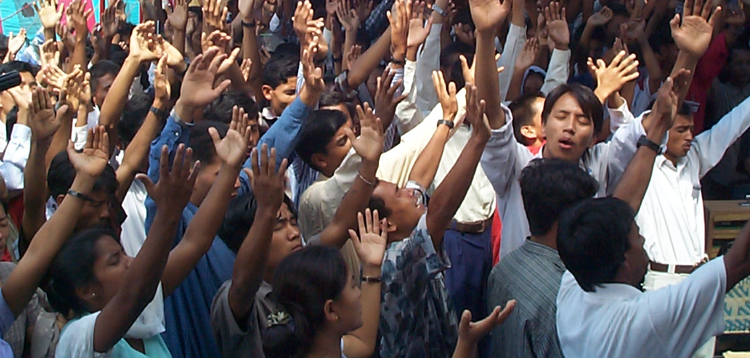
Focusing Mobilization Efforts Toward
Serving the Unengaged and Unreached
Rethinking Mobilization Strategies

Slide 2

God Himself was the first missionary...Genesis 3:9

Slide 3
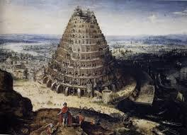
Disobedience led to God’s “Divide and Conquer” strategy Genesis 11:1-4

Slide 4
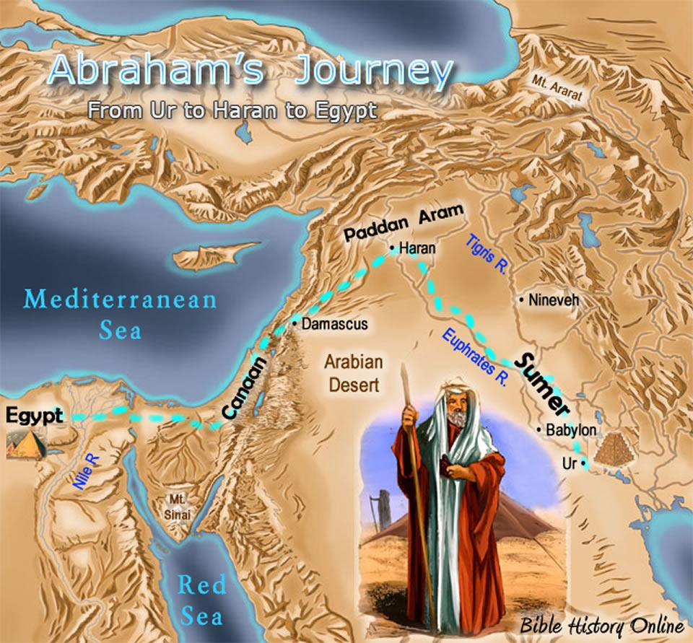
The Great Commission Part 1
Genesis 12:1-3
God’s promise to bless Abraham in Genesis 12
included His instruction that Abraham would be a blessing to all the nations…
Abraham [and we] are blessed to be a blessing.

Slide 5
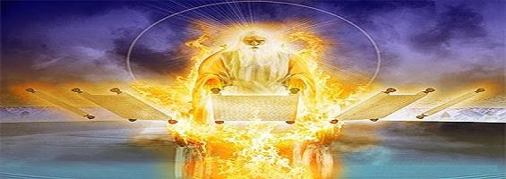
The Register of the Peoples -- Psalm 87:4-6
God has a list of every distinct group of people on earth. He keeps it because He promised Abraham every one would be reached.

Slide 6
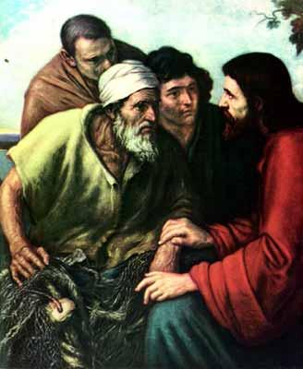
“The Upper Room Seminar” -- Luke 24:45-48
The Father sent the Son to be the Savior of the world.
Jesus came to seek and to save that which was lost.
His plan was for all nations to be reached.
He blesses us for us to bless the nations.
“As the Father hath sent Me, so send I you.”

Slide 7
“The Finale” -- Revelation 5:9-10
The Redeemed from Every Tongue, Tribe and Nation Worshiping...

Slide 8
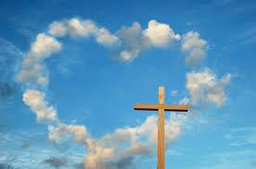
As we abide in His Presence,
we are changed from glory to glory.
We know His heart more and more;
His love compels us to reach out to others.

Slide 9
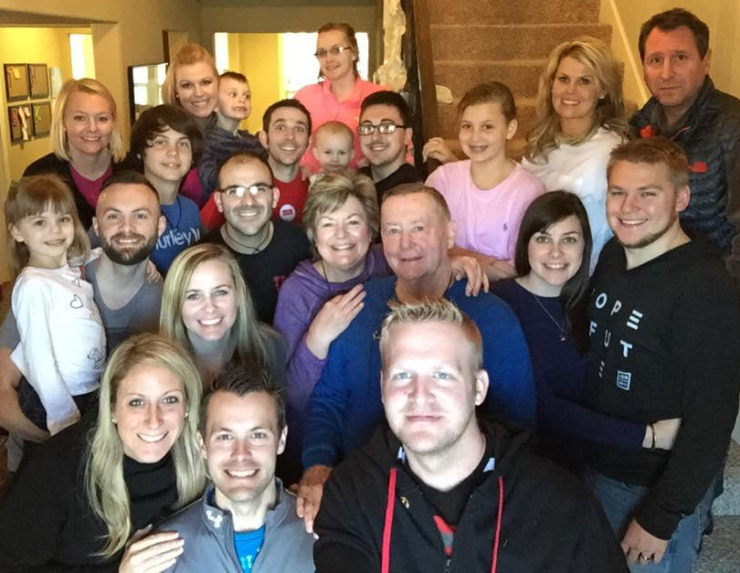
A Father & Mother are aware when even one is missing…
[in this case,
we’re missing 2 sons,
and 5 grandchildren]

Slide 10
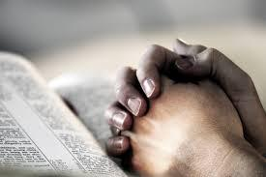
Prayer brings us into God’s presence, which changes us.
  Prayer reveals God’s plans so we can cooperate with Him in them.
    Prayer invites God’s participation and presence in the process.
Prayer obeys Jesus to ask the Lord of the Harvest to send workers (Luke 10:2).
  Prayer releases spiritual power to fulfill the call.
    Prayer exercises divine authority to change situations and people.
Prayer removes hindrances to the gospel.
  Prayer prepares the hearts of unbelievers to hear the good news.
    Prayer releases resources necessary to accomplish the task.
Prayer insures protection for workers and their work.
  Prayer IS the battle!
    Prayer maintains the victory.

Slide 11
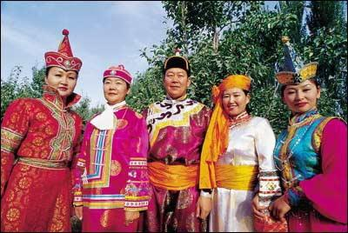
Jesus: I am here speaking with all the authority of God, who has commanded Me to give you this commission: 19 Go out and make disciples in all the nations. Ceremonially wash them through baptism in the name of the triune God: Father, Son, and Holy Spirit. 20 Then disciple them. Form them in the practices and postures that I have taught you, and show them how to follow the commands I have laid down for you. And I will be with you, day after day, to the end of the age. Matthew 18:18-20 [the Voice]
Ethnê is the Greek word Jesus used for “nation”
a word which means tribe, ethnic group or people.

Slide 12
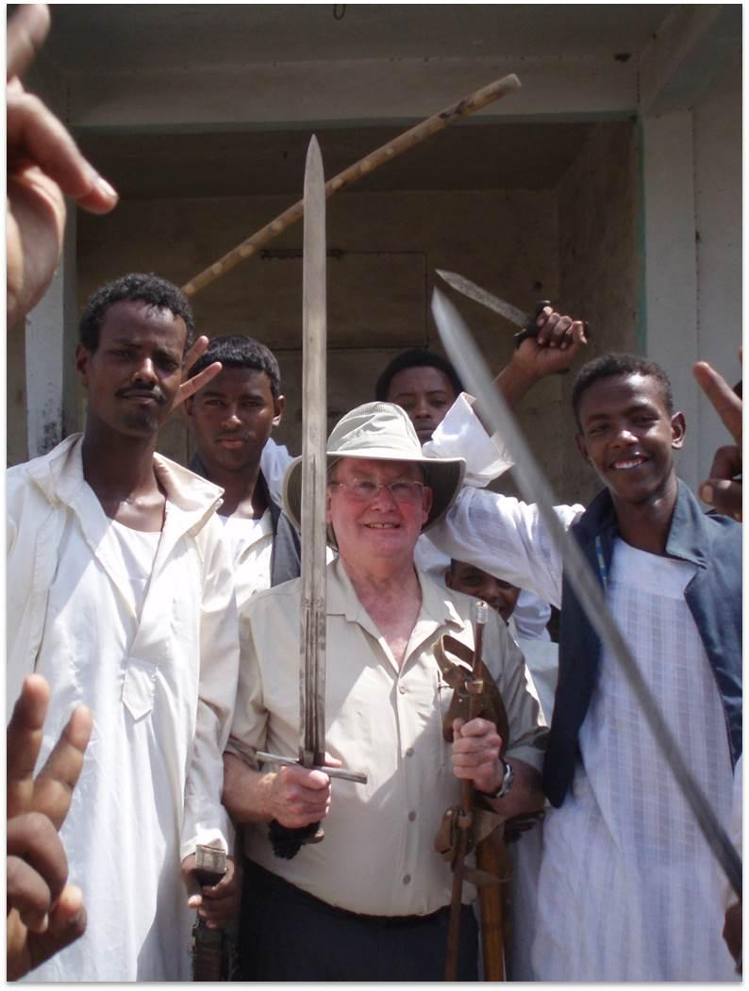
Today, 2,000 years since Jesus came,
globally, there remain
more than 7,000 people groups
with little access to the good news of Jesus Christ!

Slide 13

Global Peoples Summary from Joshua Project
Total People Groups: | 16,729
Unreached People Groups: | 7,036
% People Groups Unreached: | 42.1 | %
World Population: | 7.25 | Billion
Popl in Unreached Groups: | 3.00 | Billion
% Population in Unreached: | 41.3 | %

Slide 14

What does the term “unreached” mean?
This simply means they are a people group lacking an indigenous community of believing Christians
with adequate numbers and resources to evangelize their own people group
without outside assistance.
What does the term “unengaged” mean?
This simply means they are a people group that, as far as we can tell at this point,
have no one actively working among them
with a strategy to see reproducing fellowships developed.

Slide 15
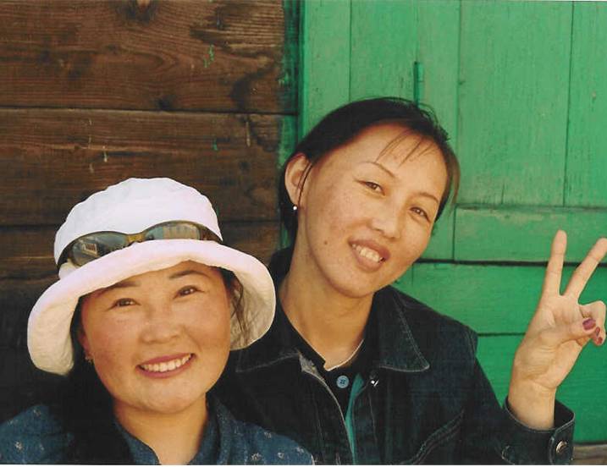
Imagine you lived in Siberia...

Slide 16
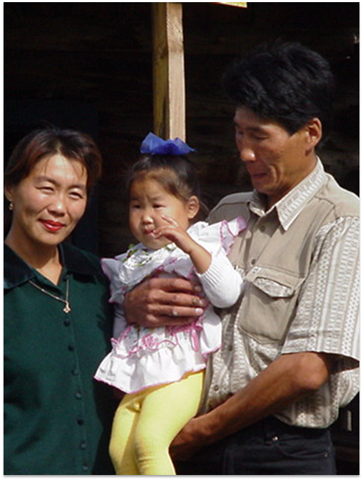
There are only 1 in 4,000 of your people who know Jesus Christ.
Likely you live in a village where there are no churches and no believers at all. You have probably never once heard the name ‘Jesus”.
You believe in the White Father, but you are afraid of the spirits that live in nature. To appease them, you offer them gifts of vodka, cigarettes, or money.

Slide 17
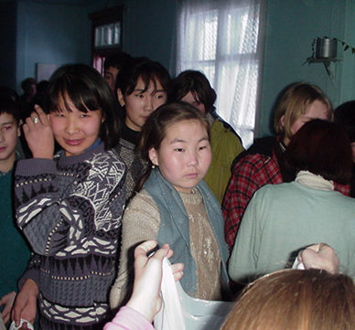
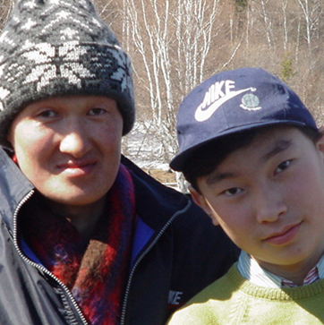
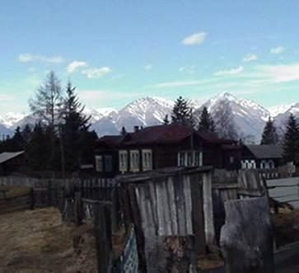
You wonder what life is really all about.

Slide 18
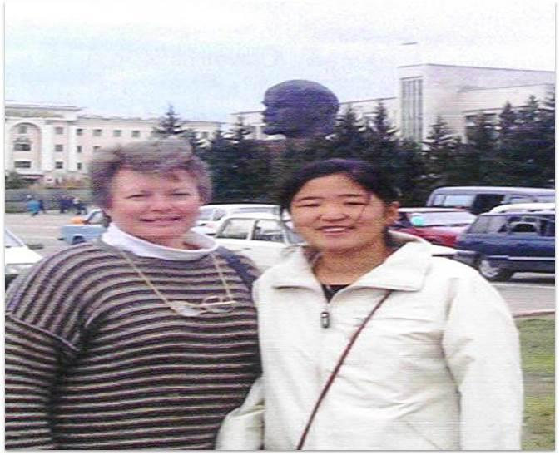
But, unless someone comes to tell you,
you will likely never know that Jesus is God’s Son
that was sent to give His life so that you would have life
and that more abundantly.

Slide 19
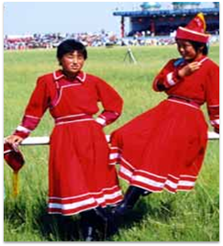
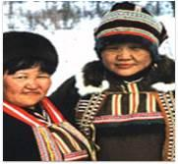
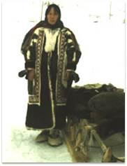
Over 40 such shamanistic people groups live in Siberia.
Most have no believers
and no one to tell them about Jesus Christ.
And these are only a few of the groups we call
Unengaged and Unreached.

Slide 20
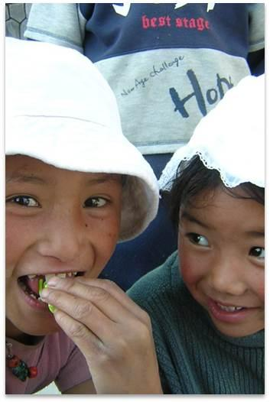
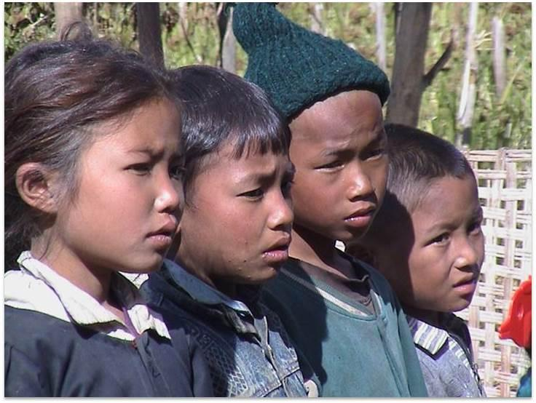
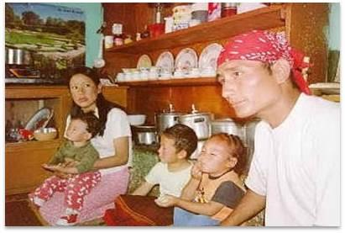
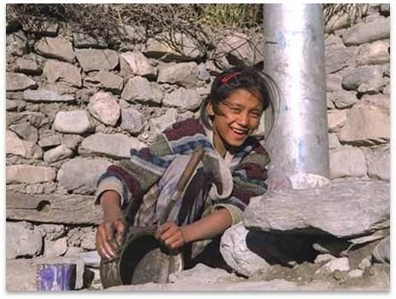
So many faces needing Jesus!

Slide 21
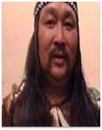
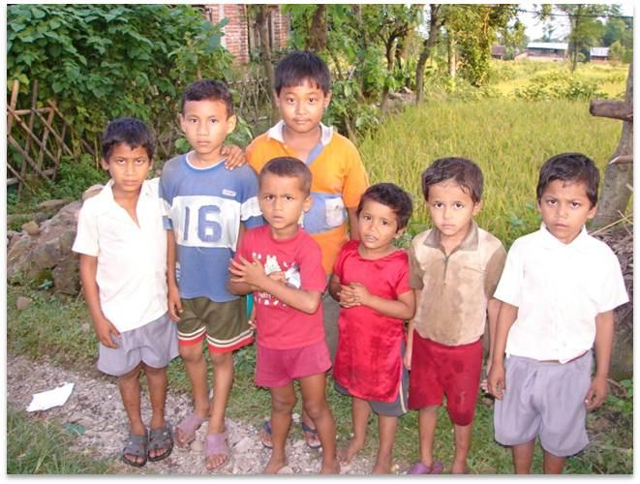
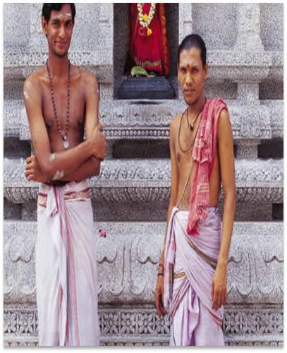
You may ask,
“Why are they still without the gospel?”

Slide 22
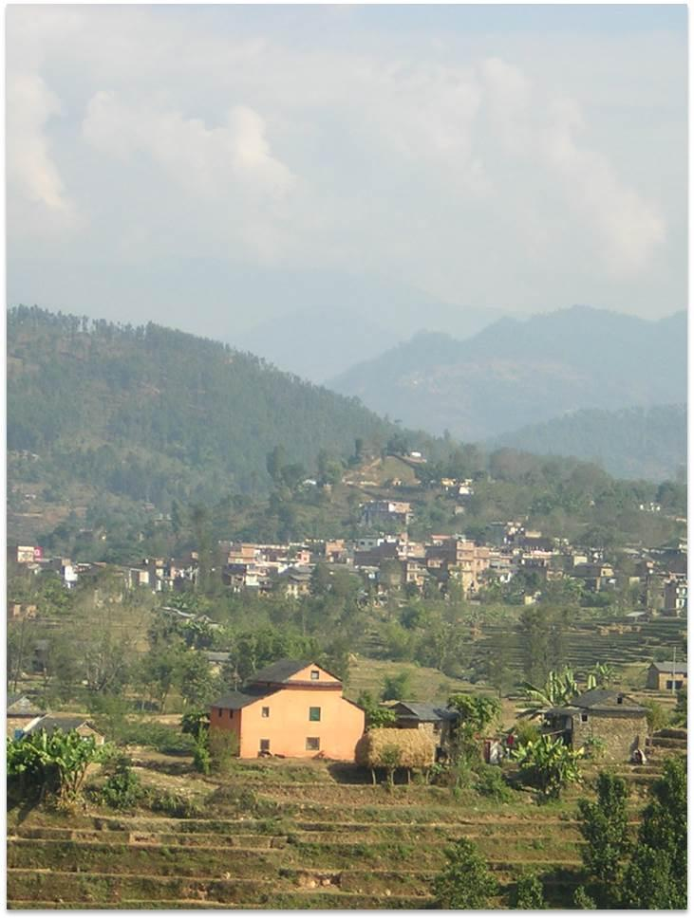
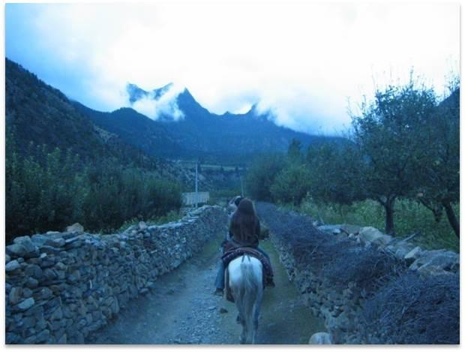
Many people groups are separated
by geographic barriers…

Slide 23
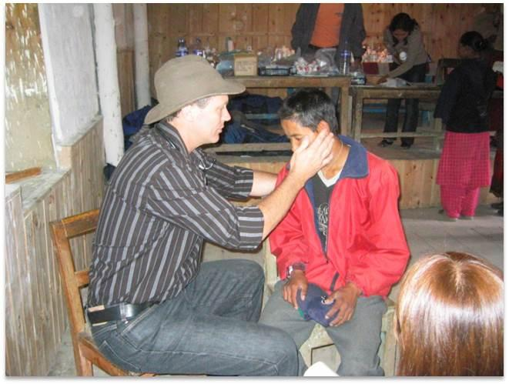
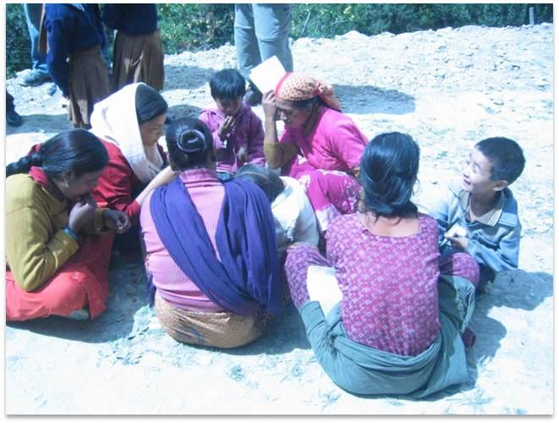
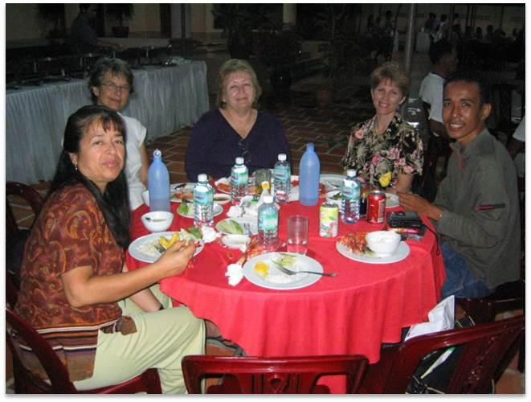
Other groups are
separated from the gospel
by linguistic barriers…

Slide 24
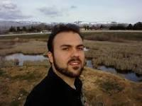
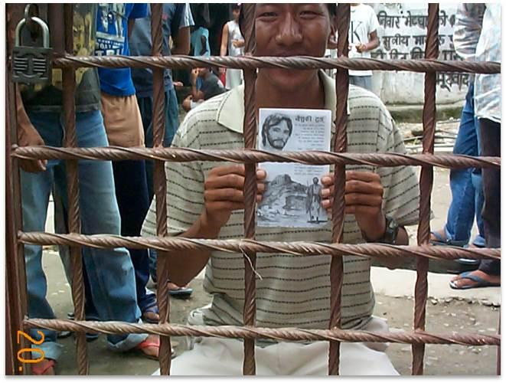
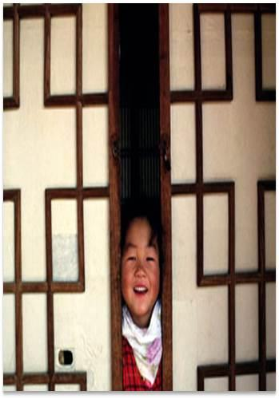
Some of the
barriers to the gospel
are political…

Slide 25
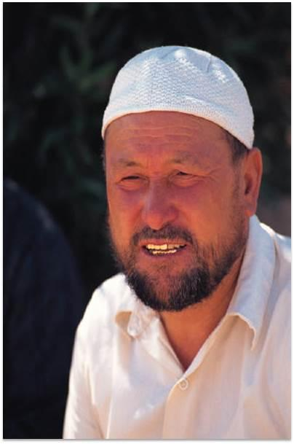
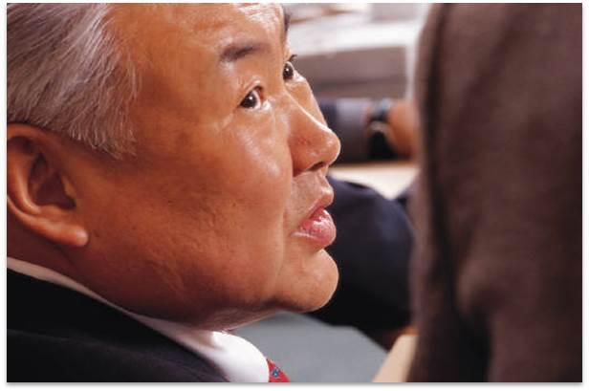
For other groups,
culture or religion creates
some of the barriers to the gospel…

Slide 26


Sometimes, however, the unreached people group may live near believers
who do not recognize their need to hear...

Slide 27
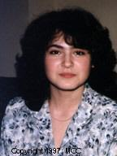
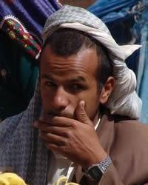
Over 200 unreached people groups live
in Europe and over 200 live in the Americas/Caribbean...

Slide 28
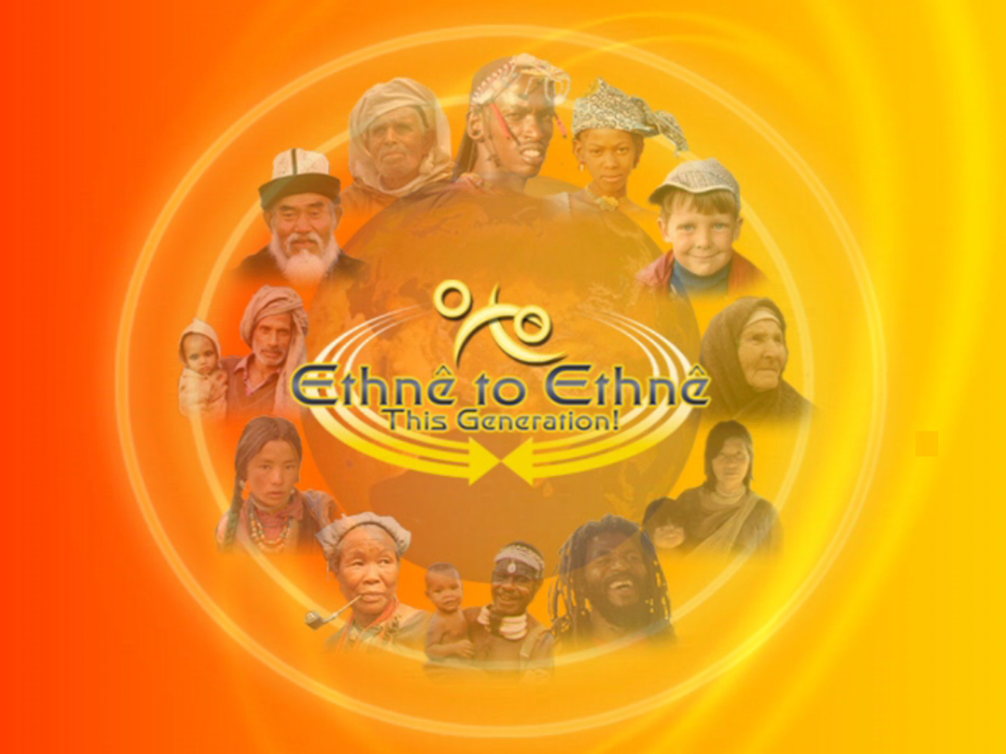
The Ethnê movement is a network of networks
“Peoples joining to glorify God among all peoples…
ethnê to ethnê…this generation!”

Slide 29
The Ethnê movement functions together
within 7 working groups…
Harvest-Linked Prayer Strategies
Holistic Gospel Movements
Frontier Crisis Response
Information Strategies
Training & Mobilization
Youth & Younger Leaders
Ethno-Arts

Slide 30
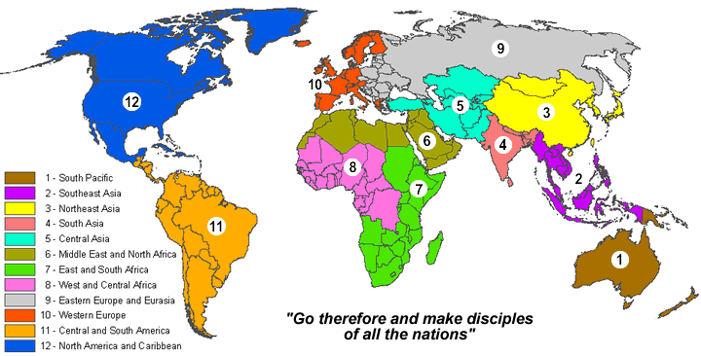
The Ethnê prayer workgroup initiated a cyclical prayer initiative in 2006 focused on global level prayer linked with strategic field outreach, region by region & month by month.

Slide 31
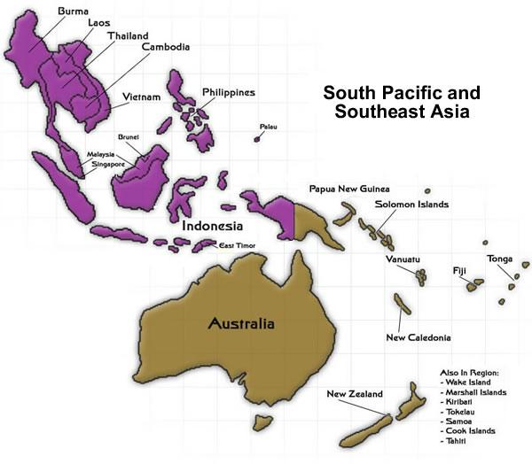
26 geopolitical nations
780 unreached people groups
over 300 million people unreached
Java Pesis Lor, Sunda and Burmese
are 100 million alone

Slide 32
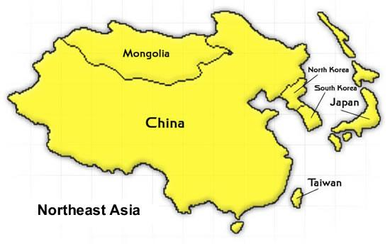
8 geopolitical nations
527 unreached people groups
over 350 million people unreached
Japanese, Xiang Han Chinese and Hakka Han Chinese are 200 million

Slide 33
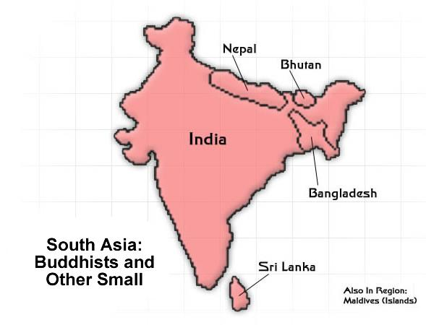
8 geopolitical nations
287 unreached people groups
nearly 60 million people unreached
Sikh Jat, Sinhalese, and Lingayat are 30 million alone

Slide 34
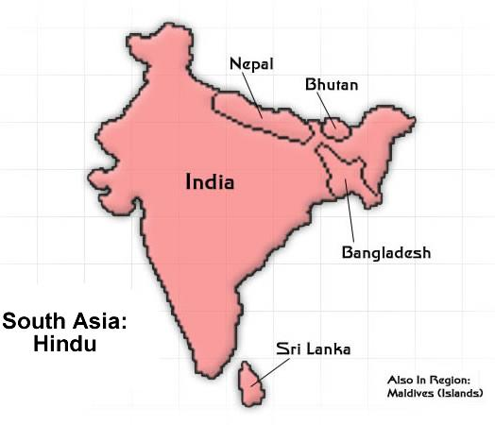
8 geopolitical nations
2,031 unreached people groups
over 1 billion people unreached
Brahman, Yadav and Chamar are 160 million alone

Slide 35

8 geopolitical nations
553 unreached people groups
over 300 million people unreached
Shaikh are over 200 million alone

Slide 36
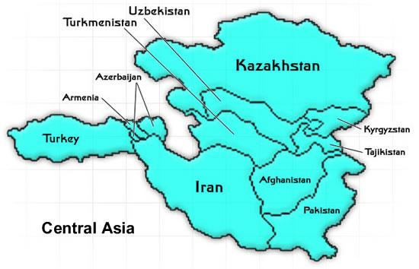
11 geopolitical nations
825 unreached people groups
over 400 million people unreached
Persian, Muslim Jat and Turk are over 100 million

Slide 37
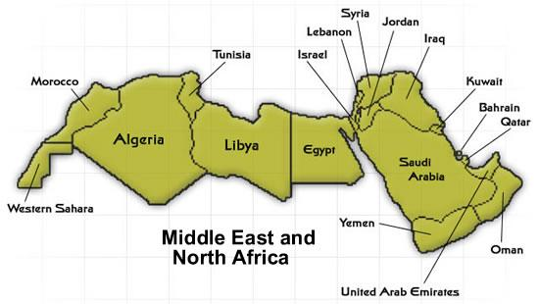
20 geopolitical nations
403 unreached people groups
over 200 million people unreached
Algerian, Moroccan, Iraqi, Saudi, Yemini and Tunisian Arabs together are over 100 million

Slide 38
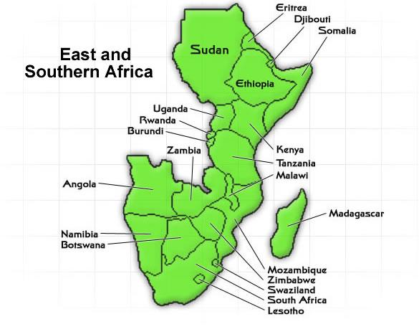
21 geopolitical nations
336 unreached people groups
over 70 million people unreached
Somali groups are over 15 million

Slide 39
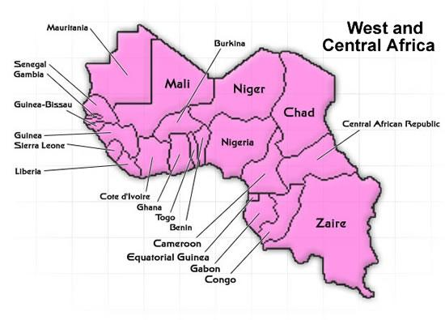
23 geopolitical nations
519 unreached people groups
over 145 million people unreached
Hausa groups number 40 million and Fulani groups another 20 million

Slide 40
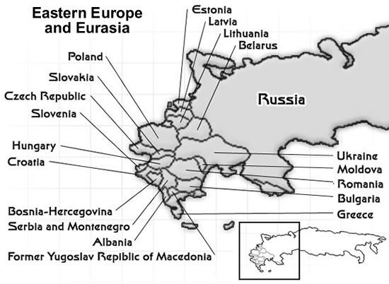
20 geopolitical nations
274 unreached people groups
over 20 million people unreached
Tatar, Bosniak, Chechen and Gheg Albanian are over 10 million

Slide 41
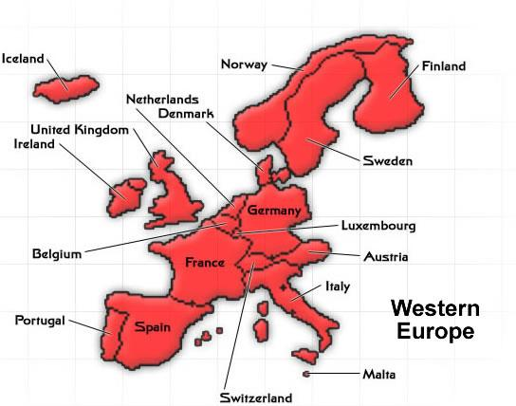
20 geopolitical nations
269 unreached people groups
over 20 million people unreached
South Asians, Turk, Algerian Arabs and Arabs are nearly 10 million

Slide 42

42 geopolitical nations
232 unreached people groups
nearly 13 million people unreached
English-speaking Jews are nearly 5 million with Punjabi and Japanese nearly 1 million each

Slide 43

“For God so loved the world that He gave His only Son…”
Jesus loved us so much that He willingly laid down His life…
But 2,000 years later, so many still have never heard this Good News!

Slide 44

We are actually losing ground--
the unreached world is growing rather than shrinking.
Is there anything we could do about this?

Slide 45

One can put 1,000 to flight, but 2 can put 10,000 to flight…
What if the Body of Christ all joined hands with God
and each other
not to build our own kingdoms, but His Kingdom?

Slide 46

What if, instead of focusing on 1 unreached group at a time,
we focused on catalyzing movements to Christ
in families of 50 or more unreached groups at the same time
so that resultant movements could cascade throughout that family?

Slide 47

Extraordinary prayer [John 15:5]
Authority of scripture [Hebrews 4:12]
Abundant gospel sowing [2 Cor. 9:6]
Intentional gathering [Matthew 18:20]
Every member a minister [Ephesians 4:11-12]
Bivocational lay leaders [Deuteronomy 8:18]
Small groups [Acts 2:42]
Churches planting churches [Matthew 28:18-20]
Rapid reproduction--urgency [Mark 5:19]
Simple church [Acts 2:42]
Enduring suffering [Hebrews 12:1-3]
Signs & wonders follow the Word [Mark 16:20]
12 KEYS
TO
FRUITFULNESS

Slide 48

“God so loved the world He gave His only Son…that whosoever believes might live”
Jesus died to purchase our redemption. He left carrying the message to us.
What will you do so those who do not yet know may receive His precious gift?

Slide 49
What part of His vineyard has He assigned to you?
Further questions? Email prayer@ethne.net
Or visit www.ethne.net

