Slide 1
PRAYING IN KINGDOM MOVEMENTS: A CASE STUDY IN 18 AFRICAN COUNTRIES

Slide 2
“Kingdom Movements” Require: (1) Much Prayer, and (2) Obedience-Based Discipleship

Slide 3
The Gospels Emphasize Jesus’ Kingdom Values and Practices that Create Kingdom Movements
Jesus’ life and His prayers
Jesus’ Kingdom of God teachings
Principles from Sending the 12 and 72
The “Trinitarian Celebration”
The Great Commission
What Jesus said after: “Pray like this…”

Slide 4
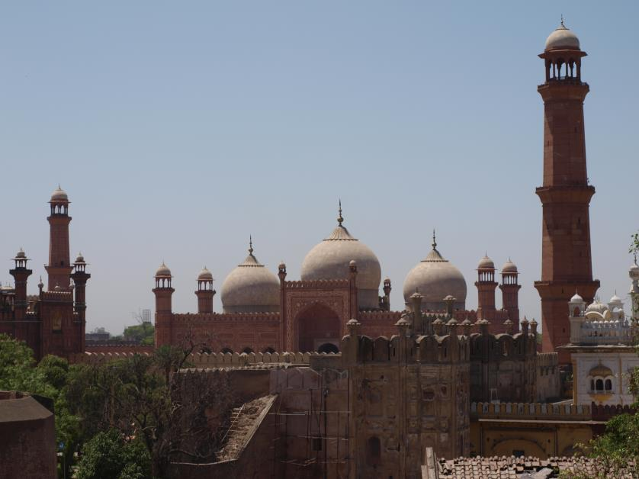
The Lord’s Prayer and the Kingdom:
God’s Glory Manifested…
God’s Kingdom Reigning…
And God’s Will Obeyed…
Among the people we serve,
as it is in heaven!

Slide 5
Kingdom Catalysts’ Prayers
God’s Goals: “His hope of our calling?”
Where to start…with whom to partner?
Ask God for an uncompromising Kingdom DNA
Pray for courageous Kingdom leadership

Slide 6
Case Study of Prayer Mobilization in Anglophone West Africa
Sierra Leone
Liberia
Gambia
Northern Nigeria
Ghana

Slide 7
DMM Intercessory Prayer Strategy in Anglophone West Africa
Intercessory prayer starts early in the DBS process among Muslims
New Muslim Christ followers start with nervous and halting prayers… until the moment of joy.
In Cityteam’s Anglophone region former Muslims historically are the most passionate intercessors!

Slide 8
Intercession Calendar for All Churches and DMM Partner Ministries
Annually: 21 days of fasting (two meals) and prayer in all churches from January 10th
Monthly: One Friday a month for a half (or whole) night of prayer
Weekly: Every Wednesday (or Thursday), fasting and prayer-- breaking fast with a shared meal, DBS, and intercessory prayer

Slide 9
Intercession Calendar for Churches and Partner Ministries (Pt.2)
Daily: 90 minute chain prayers at 40 prayer centers in the five countries
Week Days: All ministry offices and schools stop for 30 minutes of mid-day intercession.
Last day of month: All Christ Followers are encouraged to come out of their house and pray with/for their neighbors.
Last three days of December: Thanksgiving prayers and fasting

Slide 10
Regular, Dedicated Prayer Events
Daniel Prayer Meetings for whatever needs to be restored
Victory Weekend Retreats for people who are in a battle:
Personal struggles
And prayer requests from around the world
Prayer Mobilizations (every quarter) Praying for an “open heaven” in disciple making
Upper Room Prayers (every quarter) prayer gathering for all senior leaders

Slide 11
Consistent Themes of Intercession
Apostolic teams of disciple-makers/church planters
Open doors in restricted regions
People of peace to be discovered
Favor on partner ministries and their churches
Key disciple making pioneers and leaders around the world

Slide 12
Consistent Themes of Intercession (cont.)
Prayers for Movements in the Global North
Special prayer needs distributed to all the churches and prayer centers
Prayers for financial partners
A unique few thousand intercessors on call to fast and pray for urgent matters

Slide 13
Outcomes Over 10 Years: Movements Among Least Reached Peoples

Slide 14
Anglophone Regional Outcomes Over 10 Years
Engagements with one or more churches planted:
51 People groups
26 (51%) least reached
15 Urban areas
Total Movements
22 total movements (9 among “least reached”)
Total churches 8,310
4,868 among Muslims
2,515 among least reached
Total Christ Followers 381,775,
202,306 from Muslim backgrounds
71,674 among least reached

Slide 15
Outcomes: Consistent and Unusual Favor of God in Drawing Muslims to Himself
Approximately 70% of the 202,000 new Anglophone Christ Followers from Muslim backgrounds are active intercessors
A repeating story: “Please send us the storytellers.” Community transformation that becomes attractional
The first prayer camp experiment.

Slide 16
PRAYING IN KINGDOM MOVEMENTS: A CASE STUDY IN 18 AFRICAN COUNTRIES

